Slide 1
Unit IV - PHP
By
J.S.Vimali

Slide 2
Introduction
What is PHP?
PHP is an acronym for "PHP: Hypertext Preprocessor"
PHP is a widely-used, open source scripting language
PHP scripts are executed on the server
PHP is free to download and use
What is a PHP File?
PHP files can contain text, HTML, CSS, JavaScript, and PHP code
PHP code are executed on the server, and the result is returned to the browser as plain HTML
PHP files have extension ".php"
What Can PHP Do?
PHP can generate dynamic page content
PHP can create, open, read, write, delete, and close files on the server
PHP can collect form data
PHP can send and receive cookies
PHP can add, delete, modify data in your database
PHP can be used to control user-access
PHP can encrypt data

Slide 3
With PHP you are not limited to output HTML. You can output images, PDF files, and even Flash movies. You can also output any text, such as XHTML and XML.
Why PHP?
PHP runs on various platforms (Windows, Linux, Unix, Mac OS X, etc.)
PHP is compatible with almost all servers used today (Apache, IIS, etc.)
PHP supports a wide range of databases
PHP is free. Download it from the official PHP resource: www.php.net
PHP is easy to learn and runs efficiently on the server side
To start using PHP, you can:
Find a web host with PHP and MySQL support
Install a web server on your own PC, and then install PHP and MySQL
Use a Web Host with PHP Support
• If your server has activated support for PHP you do not need to do anything.
• Just create some .php files, place them in your web directory, and the server will automatically parse them for you.
• You do not need to compile anything or install any extra tools.
• Because PHP is free, most web hosts offer PHP support.
• Set Up PHP on Your Own PC

Slide 4
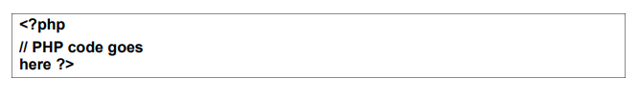
However, if your server does not support PHP, you must:
install a web server
install PHP
install a database, such as MySQL
PHP Scripts
Basic PHP Syntax
A PHP script can be placed anywhere in the document.
A PHP script starts with
<?php and ends with ?>

Slide 5
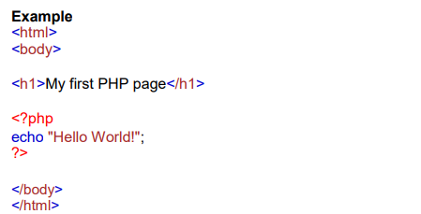
PHP statements end with a semicolon (;)
Comments in PHP
A comment in PHP code is a line that is not read/executed as part of the program. Its only purpose is to be read by someone who is looking at the code.

Slide 6
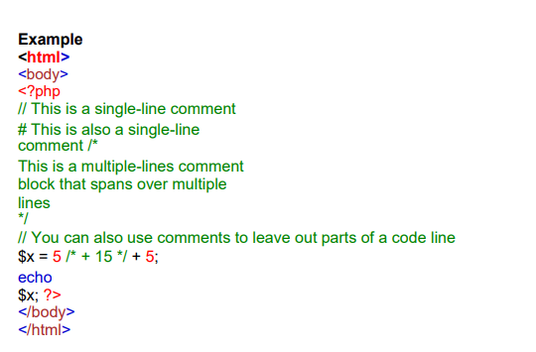
Comments can be used to:
Let others understand what you are doing
Remind yourself of what you did - Most programmers have experienced coming back to their own work a year or two later and having to re-figure out what they did. Comments can remind you of what you were thinking when you wrote the code

Slide 7
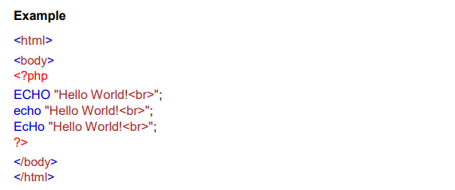
In the example below, only the first statement will display the value of the $color variable (this is because $color, $COLOR, and $coLOR are treated as three different variables):

Slide 8
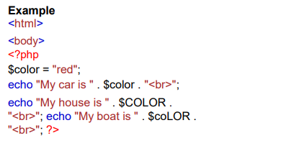


Slide 9
Data Types
Variables can store data of different types, and different data types can do different things. PHP supports the following data types:
String
Integer
Float (floating point numbers - also called double) Boolean
Array
Object
NULL
Resource
PHP String
A string is a sequence of characters, like "Hello world!".
A string can be any text inside quotes. You can use single or double quotes:

Slide 10
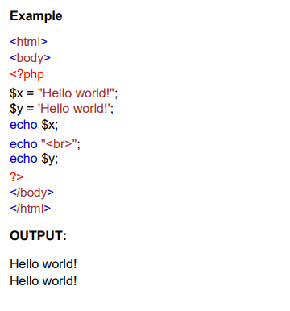

Slide 11
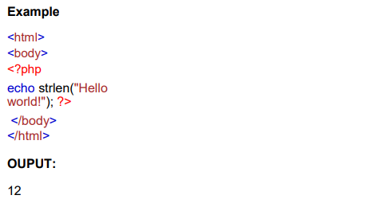
String Functions
Get The Length of a String
The PHP strlen() function returns the length of a string.
The example below returns the length of the string "Hello world!":

Slide 12
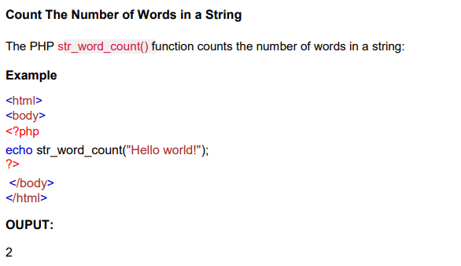

Slide 13
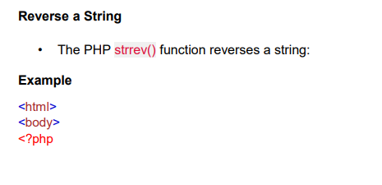
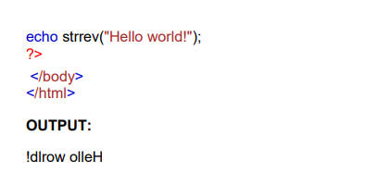
Search For a Specific Text Within a String
The PHP strpos() function searches for a specific text within a string.
If a match is found, the function returns the character position of the first match. If no match is found, it will return FALSE.
The example below searches for the text "world" in the string "Hello world!":

Slide 14
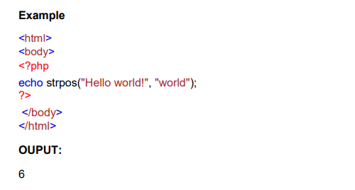
Replace Text Within a String
The PHP str_replace() function replaces some characters with some other characters in a string.
The example below replaces the text "world" with "Dolly":

Slide 15
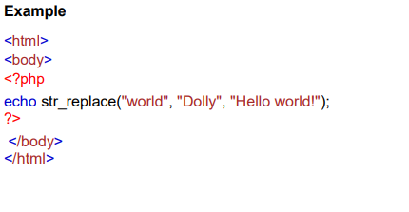


Slide 16
PHP Integer
An integer data type is a non-decimal number between -2,147,483,648 and 2,147,483,647.
Rules for integers:
An integer must have at least one digit
An integer must not have a decimal point
An integer can be either positive or negative
Integers can be specified in three formats: decimal (10-based), hexadecimal (16- based - prefixed with 0x) or octal (8-based - prefixed with 0)
In the following example $x is an integer. The PHP var_dump() function returns the data type and value:

Slide 17
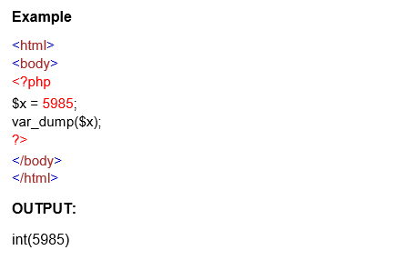
PHP Float
A float (floating point number) is a number with a decimal point or a number in exponential form.
In the following example $x is a float. The PHP var_dump() function returns the data type and value:

Slide 18
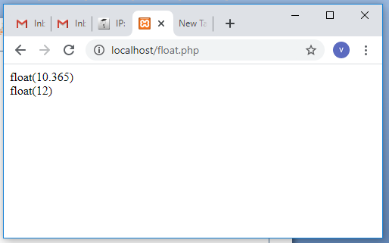
Example
<html>
<body>
<?php
$x=10.365;
$y=12.00;
var_dump($x);
echo "<br/>";
var_dump($y);
?>
</body>
</html>
Output

Slide 19
PHP Boolean
A Boolean represents two possible states: TRUE or FALSE.
$x = true;
$y = false;
Booleans are often used in conditional testing. You will learn more about conditional testing in later classes.
PHP Array
An array stores multiple values in one single variable:
An array is a special variable, which can hold more than one value at a time.
If you have a list of items (a list of car names, for example), storing the cars in single variables could look like this:
$cars1 = "Volvo";
$cars2 = "BMW";
$cars3 = "Toyota";
However, what if you want to loop through the cars and find a specific one? And what if you had not 3 cars, but 300?
The solution is to create an array!
An array can hold many values under a single name, and you can access the values by referring to an index number.

Slide 20
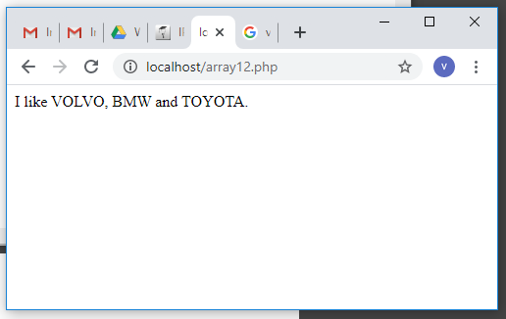
Example
<html>
<body>
<?php
$cars=array("VOLVO","BMW","TOYOTA");
echo "I like ".$cars[0].", ".$cars[1]." and ".$cars[2].".";
?>
</body>
</html>
Output

Slide 21
Create an Array in PHP
In PHP, the array() function is used to create an array:
array();
In PHP, there are three types of arrays:
Indexed arrays - Arrays with a numeric index
Associative arrays - Arrays with named keys
Multidimensional arrays - Arrays containing one or more arrays
Variables
Variables are "containers" for storing information.
Creating (Declaring) PHP Variables
In PHP, a variable starts with the $ sign, followed by the name of the variable:
Note: Unlike other programming languages, PHP has no command for declaring a variable. It is created the moment you first assign a value to it.

Slide 22
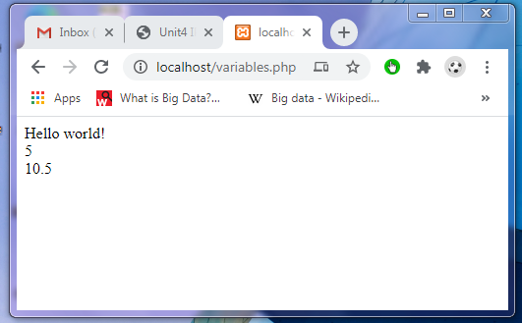
<html>
<body>
<?php
$txt = "Hello world!";
$x = 5;
$y = 10.5;
echo $txt;
echo "<br>";
echo $x;
echo "<br>";
echo $y;
?>
</body>
</html>

Slide 23
Rules for PHP variables:
A variable can have a short name (like x and y) or a more descriptive name (age, carname, total_ volume).
A variable starts with the $ sign, followed by the name of the variable
A variable name must start with a letter or the underscore character
A variable name cannot start with a number
A variable name can only contain alpha-numeric characters and underscores (Az, 0-9, and _ )
Variable names are case-sensitive ($age and $AGE are two different variables)

Slide 24
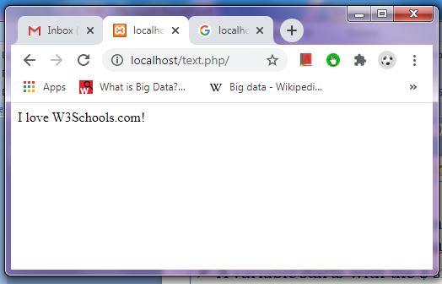
<html>
<body>
<?php
$txt = "W3Schools.com";
echo "I love $txt!";
?>
</body>
</html>

Slide 25
<html>
<body>
<?php
$txt = "W3Schools.com";
echo "I love " . $txt . "!";
?>
</body>
</html>

Slide 26
<html>
<body>
<?php
$x = 5;
$y = 4;
echo $x + $y;
?>
</body>
</html>

Slide 27
PHP Variables Scope
In PHP, variables can be declared anywhere in the script.
The scope of a variable is the part of the script where the variable can be referenced/used.
PHP has three different variable scopes:
local
global
static
Global and Local Scope
A variable declared outside a function has a GLOBAL SCOPE and can only be accessed outside a function:

Slide 28
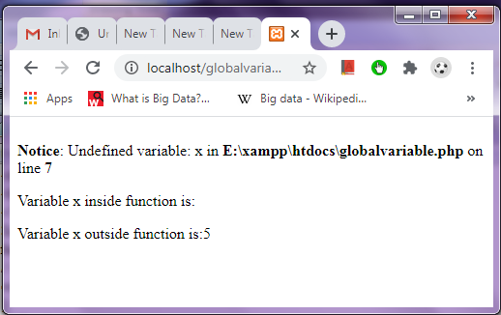
<html>
<body>
<?php
$x = 5; // global scope
function myTest() {
// using x inside this function will generate an error
echo "<p>Variable x inside function is: $x</p>";
}
myTest();
echo "<p>Variable x outside function is:$x</p>";
?>
</body>
</html>

Slide 29
<html>
<body>
<?php
$x = 5;
$y = 10;
function myTest() {
global $x, $y;
$y= $x + $y;
}
myTest(); // run function
echo $y; // output the new value for variable $y
?>
</body>
</html>

Slide 30
The static Keyword
Normally, when a function is completed/executed, all of its variables are deleted. However, sometimes we want a local variable NOT to be deleted.
We need it for a further job. To do this, use the static keyword when you first declare the variable:
Example
<html>
<body>
<?php
function myTest() {
static $x = 0;
echo $x;
$x++;
}
myTest();
echo "<br>";
myTest();
echo "<br>";
myTest();
?>
</body>
</html>

Slide 31
echo and print Statements
In PHP there are two basic ways to get output: echo and print.
echo and print are more or less the same. They are both used to output data to the screen.
The differences are small:
echo has no return value while print has a return value of 1 so it can be used in expressions. echo can take multiple parameters (although such usage is rare) while print can take one argument. echo is marginally faster than print.
echo Statement
The echo statement can be used with or without parentheses: echo or echo(). Display Text The following example shows how to output text with the echo command (notice that the text can contain HTML markup):

Slide 32
<html>
<body>
<?php
echo "<h2>PHP is Fun!</h2>";
echo "Hello world!<br>";
echo "I'm about to learn PHP!<br>";
echo "This ", "string ", "was ", "made ", "with multiple parameters.";
?>
</body>
</html>

Slide 33
The PHP print Statement
The print statement can be used with or without parentheses: print or print(). Display Text The following example shows how to output text with the print command (notice that the text can contain HTML mark
<html>
<body>
<?php
print "<h2>PHP is Fun!</h2>";
print "Hello world!<br>";
print "I'm about to learn PHP!";
?>
</body>
</html>
OUTPUT:
PHP is Fun!
Hello world!
I'm about to learn PHP!

Slide 34
PHP Objects
An Object is an individual instance of the data structure defined by a class. We define a class once and then make many objects that belong to it. Objects are also known as instances.
Creating an Object: Following is an example of how to create object using new operator.
class Books
{
// Members of class Books
}
// Creating three objects of Books
$physics = new Books;
$maths = new Books;
$chemistry = new Books;

Slide 35
<?php
class Books {
var $price;
var $title;
function setPrice($par){
$this->price = $par;
}
function getPrice(){
echo $this->price."<br>";
}
function setTitle($par){
$this->title = $par;
}
function getTitle(){
echo $this->title."<br>" ;
}
}
$maths = new Books;
$maths->setTitle( "Algebra" ); /* Setting title and prices for the object */
$maths->setPrice( 7 );
$maths->getTitle();
$maths->getPrice(); /* Calling Member Functions */
?>

Slide 36
The count() function is used to return the length (the number of elements) of an array:
Example
<!DOCTYPE html>
<html>
<body>
<?php
$cars = array("Volvo", "BMW", "Toyota");
echo count($cars);
?>
</body>
</html>

Slide 37
PHP - Sort Functions For Arrays
sort() - sort arrays in ascending order
rsort() - sort arrays in descending order
asort() - sort associative arrays in ascending order, according to the value
ksort() - sort associative arrays in ascending order, according to the key
arsort() - sort associative arrays in descending order, according to the value
krsort() - sort associative arrays in descending order, according to the key

Slide 38
Sort Array in Ascending Order - sort()
<!DOCTYPE html>
<html>
<body>
<?php
$cars = array("Volvo", "BMW", "Toyota");
sort($cars);
$clength = count($cars);
for($x = 0; $x < $clength; $x++) {
echo $cars[$x];
echo "<br>";
}
?>
</body>
</html>

Slide 39
<!DOCTYPE html>
<html>
<body>
<?php
$numbers = array(4, 6, 2, 22, 11);
sort($numbers);
$arrlength = count($numbers);
for($x = 0; $x < $arrlength; $x++) {
echo $numbers[$x];
echo "<br>";
}
?>
</body>
</html>

Slide 40
Sort Array in Descending Order - rsort()
<!DOCTYPE html>
<html>
<body>
<?php
$cars = array("Volvo", "BMW", "Toyota");
rsort($cars);
$clength = count($cars);
for($x = 0; $x < $clength; $x++) {
echo $cars[$x];
echo "<br>";
}
?>
</body>
</html>

Slide 41
<!DOCTYPE html>
<html>
<body>
<?php
$numbers = array(4, 6, 2, 22, 11);
rsort($numbers);
$arrlength = count($numbers);
for($x = 0; $x < $arrlength; $x++) {
echo $numbers[$x];
echo "<br>";
}
?>
</body>
</html>

Slide 42
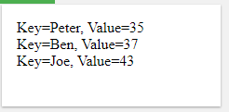
Sort Array (Ascending Order), According to Value - asort()
<!DOCTYPE html>
<html>
<body>
<?php
$age = array("Peter"=>"35", "Ben"=>"37", "Joe"=>"43");
asort($age);
foreach($age as $x => $x_value) {
echo "Key=" . $x . ", Value=" . $x_value;
echo "<br>";
}
?>
</body>
</html>

Slide 43
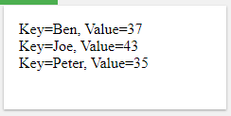
Sort Array (Ascending Order), According to Key - ksort()
<!DOCTYPE html>
<html>
<body>
<?php
$age = array("Peter"=>"35", "Ben"=>"37", "Joe"=>"43");
ksort($age);
foreach($age as $x => $x_value) {
echo "Key=" . $x . ", Value=" . $x_value;
echo "<br>";
}
?>
</body>
</html>

Slide 44
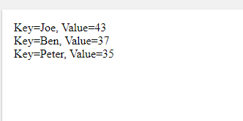
Sort Array (Descending Order), According to Value - arsort()
<!DOCTYPE html>
<html>
<body>
<?php
$age = array("Peter"=>"35", "Ben"=>"37", "Joe"=>"43");
arsort($age);
foreach($age as $x => $x_value) {
echo "Key=" . $x . ", Value=" . $x_value;
echo "<br>";
}
?>
</body>
</html>

Slide 45
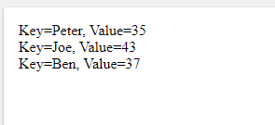
Sort Array (Descending Order), According to Key - krsort()
<!DOCTYPE html>
<html>
<body>
<?php
$age = array("Peter"=>"35", "Ben"=>"37", "Joe"=>"43");
krsort($age);
foreach($age as $x => $x_value) {
echo "Key=" . $x . ", Value=" . $x_value;
echo "<br>";
}
?>
</body>
</html>

Slide 46
PHP Operators
Operators are used to perform operations on variables and values.
PHP divides the operators in the following groups:
Arithmetic operators
Assignment operators
Comparison operators
Increment/Decrement operators
Logical operators
String operators
Array operators
PHP Arithmetic Operators
The PHP arithmetic operators are used with numeric values to perform common arithmetical operations, such as addition, subtraction, multiplication etc.

Slide 47
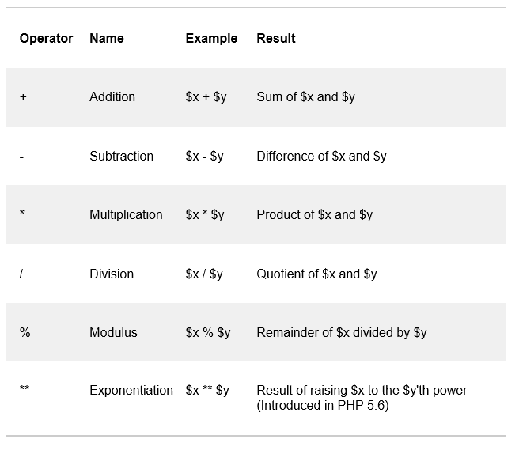

Slide 48
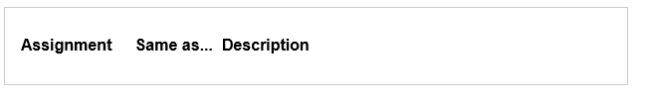
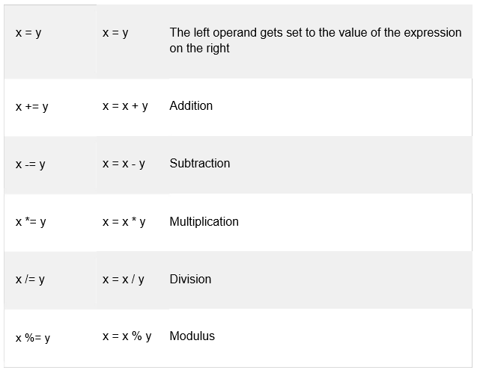
PHP Assignment Operators
The PHP assignment operators are used with numeric values to write a value to a variable.
The basic assignment operator in PHP is "=". It means that the left operand gets set to the value of the assignment expression on the right.

Slide 49
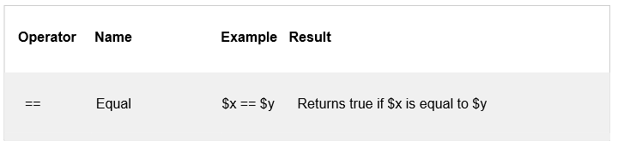
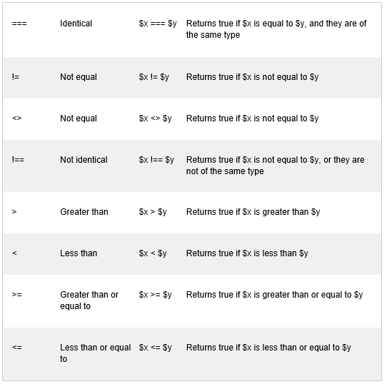
PHP Comparison Operators
The PHP comparison operators are used to compare two values (number or string):

Slide 50
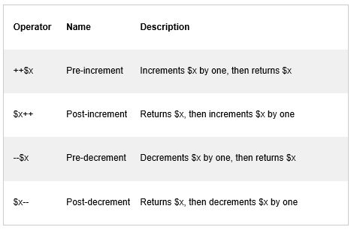
PHP Increment / Decrement Operators
The PHP increment operators are used to increment a variable's value.
The PHP decrement operators are used to decrement a variable's value.

Slide 51
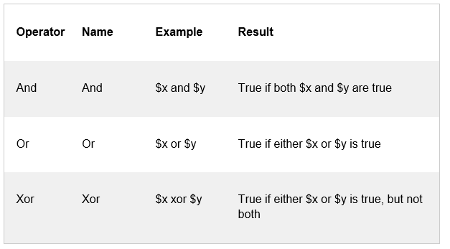
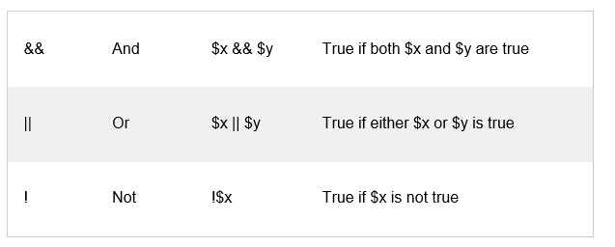
PHP Logical Operators
The PHP logical operators are used to combine conditional statements.

Slide 52
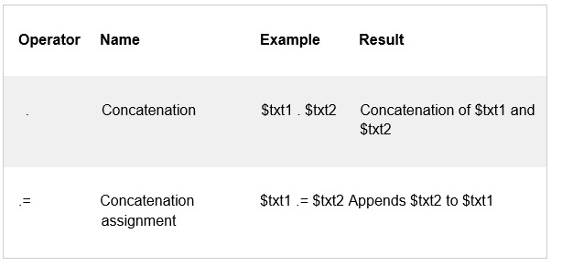
PHP String Operators
PHP has two operators that are specially designed for strings.

Slide 53
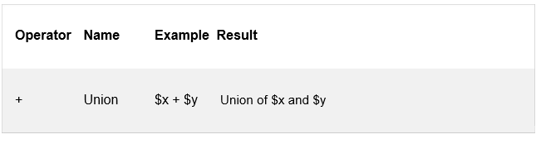
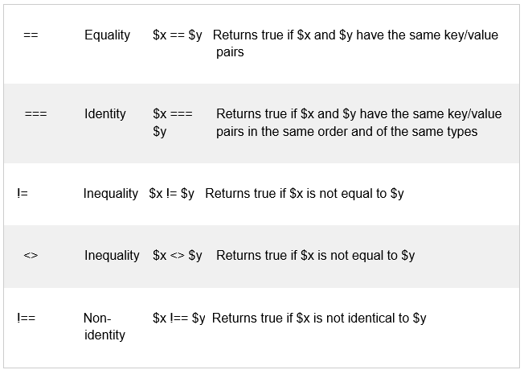
PHP Array Operators
The PHP array operators are used to compare arrays.

Slide 54
PHP Conditional Statements
Very often when you write code, you want to perform different actions for different conditions. You can use conditional statements in your code to do this.
In PHP we have the following conditional statements:
• if statement - executes some code if one condition is true
• if...else statement - executes some code if a condition is true and another code if that condition is false
• if...elseif....else statement - executes different codes for more than two conditions
• switch statement - selects one of many blocks of code to be executed

Slide 55
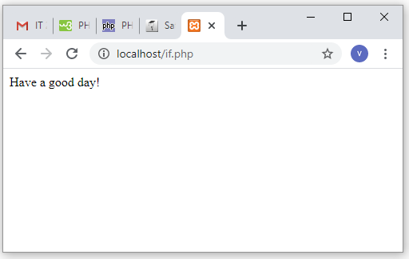
The if Statement
• The if statement executes some code if one condition is true.
Syntax
if (condition)
{
code to be executed if condition is true;
}
<html>
<head><title>IF LOOP</title>
</head>
<body>
<?php
$t=date("H");
if($t<"20")
{
print "Have a good day!";
}
?>
</body>
</html>

Slide 56
The if...else Statement
The if...else statement executes some code if a condition is true and another code if that condition is false.
Syntax
if (condition)
{ code to be executed if condition is true; }
else
{ code to be executed if condition is false; }

Slide 57
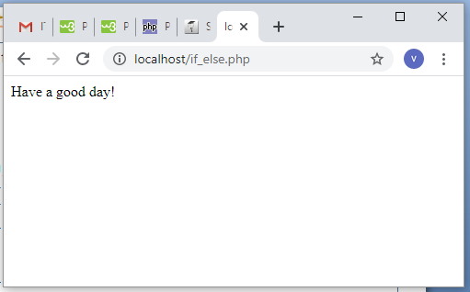
<!DOCTYPE html>
<html>
<body>
<?php
$t = date("H");
if ($t < "20") {
echo "Have a good day!";
} else {
echo "Have a good night!";
}
?>
</body>
</html>

Slide 58
The if...elseif...else Statement
The if...elseif...else statement executes different codes for more than two conditions.
Syntax
if (condition) { code to be executed if this condition is true; } elseif (condition) { code to be executed if first condition is false and this condition is true; } else { code to be executed if all conditions are false; }

Slide 59
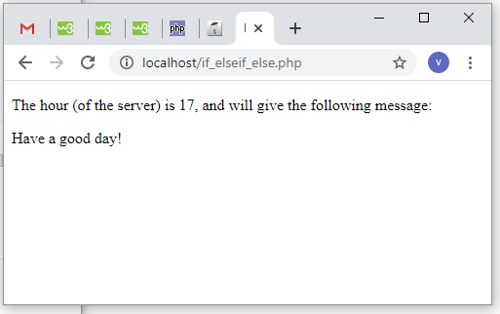
<!DOCTYPE html>
<html>
<body>
<?php
$t = date("H");
echo "<p>The hour (of the server) is " . $t;
echo ", and will give the following message:</p>";
if ($t < "10") {
echo "Have a good morning!";
} elseif ($t < "20") {
echo "Have a good day!";
} else {
echo "Have a good night!";
}
?>
</body>
</html>

Slide 60
The PHP switch Statement
Use the switch statement to select one of many blocks of code to be executed.
Syntax
switch (n)
{ case label1: code to be executed if n=label1; break; case label2: code to be executed if n=label2; break; case label3: code to be executed if n=label3; break; ... default: code to be executed if n is different from all labels; }

Slide 61
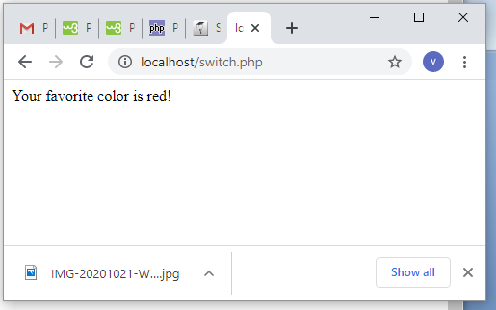
<!DOCTYPE html>
<html><body>
<?php
$favcolor = "red";
switch ($favcolor) {
case "red":
echo "Your favorite color is red!";
break;
case "blue":
echo "Your favorite color is blue!";
break;
case "green":
echo "Your favorite color is green!";
break;
default:
echo "Your favorite color is neither red, blue, nor green!";
}
?>
</body></html>

Slide 62
PHP Loops
Often when you write code, you want the same block of code to run over and over again a certain number of times. So, instead of adding several almost equal code-lines in a script, we can use loops.
Loops are used to execute the same block of code again and again, as long as a certain condition is true.
In PHP, we have the following loop types:
while - loops through a block of code as long as the specified condition is true
do...while - loops through a block of code once, and then repeats the loop as long as the specified condition is true
for - loops through a block of code a specified number of times
foreach - loops through a block of code for each element in an array

Slide 63
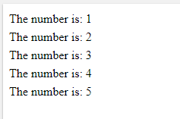
The PHP while Loop
The while loop executes a block of code as long as the specified condition is true.
Syntax
while (condition is true)
{ code to be executed;
}
Example
<!DOCTYPE html>
<html>
<body>
<?php
$x = 1;
while($x <= 5) {
echo "The number is: $x <br>";
$x++;
}
?>
</body>
</html>

Slide 64
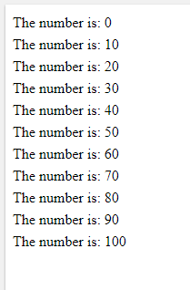
<!DOCTYPE html>
<html>
<body>
<?php
$x = 0;
while($x <= 100) {
echo "The number is: $x <br>";
$x+=10;
}
?>
</body>
</html>

Slide 65
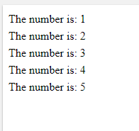
The PHP do...while Loop
The do...while loop will always execute the block of code once, it will then check the condition, and repeat the loop while the specified condition is true.
Syntax
do { code to be executed; }
while (condition is true);
<!DOCTYPE html>
<html>
<body>
<?php
$x = 1;
do {
echo "The number is: $x <br>";
$x++;
} while ($x <= 5);
?>
</body>
</html>

Slide 66
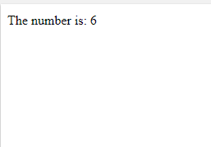
<!DOCTYPE html>
<html>
<body>
<?php
$x = 6;
do {
echo "The number is: $x <br>";
$x++;
} while ($x <= 5);
?>
</body>
</html>
In a do...while loop the condition is tested AFTER executing the statements within the loop. This means that the do...while loop will execute its statements at least once, even if the condition is false. See example below.

Slide 67
The PHP for Loop
The for loop is used when you know in advance how many times the script should run.
Syntax
for (init counter; test counter; increment counter) { code to be executed for each iteration; }
Parameters:
init counter: Initialize the loop counter value
test counter: Evaluated for each loop iteration. If it evaluates to TRUE, the loop continues. If it evaluates to FALSE, the loop ends.
increment counter: Increases the loop counter value

Slide 68
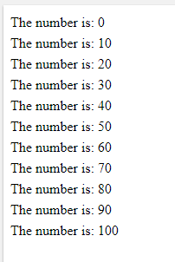
<!DOCTYPE html>
<html>
<body>
<?php
for ($x = 0; $x <= 100; $x+=10) {
echo "The number is: $x <br>";
}
?>
</body>
</html>

Slide 69
The PHP foreach Loop
The foreach loop works only on arrays, and is used to loop through each key/value pair in an array.
Syntax
foreach ($array as $value)
{ code to be executed;
}
For every loop iteration, the value of the current array element is assigned to $value and the array pointer is moved by one, until it reaches the last array element.

Slide 70
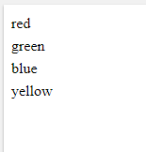
<!DOCTYPE html>
<html>
<body>
<?php
$colors = array("red", "green", "blue", "yellow");
foreach ($colors as $value) {
echo "$value <br>";
}
?>
</body>
</html>

Slide 71
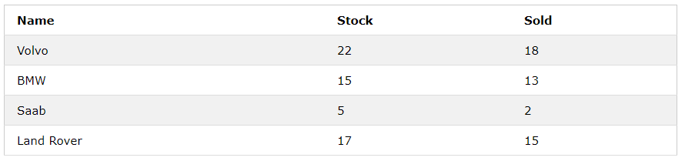
Two-dimensional Arrays
A two-dimensional array is an array of arrays (a three-dimensional array is an array of arrays of arrays).
First, take a look at the following table:

Slide 72
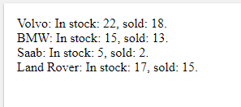
<!DOCTYPE html>
<html>
<body>
<?php
$cars = array (
array("Volvo",22,18),
array("BMW",15,13),
array("Saab",5,2),
array("Land Rover",17,15)
);
echo $cars[0][0].": In stock: ".$cars[0][1].", sold: ".$cars[0][2].".<br>";
echo $cars[1][0].": In stock: ".$cars[1][1].", sold: ".$cars[1][2].".<br>";
echo $cars[2][0].": In stock: ".$cars[2][1].", sold: ".$cars[2][2].".<br>";
echo $cars[3][0].": In stock: ".$cars[3][1].", sold: ".$cars[3][2].".<br>";
?>
</body></html>

Slide 73
PHP Functions
PHP User Defined Functions
Besides the built-in PHP functions, it is possible to create your own functions.
A function is a block of statements that can be used repeatedly in a program.
A function will not execute automatically when a page loads.
A function will be executed by a call to the function.
Create a User Defined Function in PHP
A user-defined function declaration starts with the word function:
Syntax
function functionName()
{ code to be executed;
}

Slide 74

<!DOCTYPE html>
<html>
<body>
<?php
function writeMsg()
{
echo "Hello world!";
}
writeMsg();
?>
</body>
</html>

Slide 75
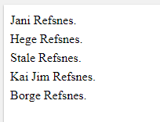
PHP Function Arguments
Information can be passed to functions through arguments. An argument is just like a variable.
Arguments are specified after the function name, inside the parentheses. You can add as many arguments as you want, just separate them with a comma.
The following example has a function with one argument ($fname). When the familyName() function is called, we also pass along a name (e.g. Jani), and the name is used inside the function, which outputs several different first names, but an equal last name:
<!DOCTYPE html>
<html>
<body>
<?php
function familyName($fname) {
echo "$fname Refsnes.<br>";
}
familyName("Jani");
familyName("Hege");
familyName("Stale");
familyName("Kai Jim");
familyName("Borge");
?></body></html>

Slide 76
PHP is a Loosely Typed Language
In the example above, notice that we did not have to tell PHP which data type the variable is.
PHP automatically associates a data type to the variable, depending on its value. Since the data types are not set in a strict sense, you can do things like adding a string to an integer without causing an error.
In PHP 7, type declarations were added. This gives us an option to specify the expected data type when declaring a function, and by adding the strict declaration, it will throw a "Fatal Error" if the data type mismatches.
In the following example we try to send both a number and a string to the function without using strict:

Slide 77
<?php
function addNumbers(int $a, int $b) {
return $a + $b;
}
echo addNumbers(5, "5 days");
// since strict is NOT enabled "5 days" is changed to int(5), and it will return 10
?>

Slide 78
To specify strict we need to set declare(strict_types=1);. This must be on the very first line of the PHP file.
In the following example we try to send both a number and a string to the function, but here we have added the strict declaration:
<?php declare(strict_types=1); // strict requirement
function addNumbers(int $a, int $b) {
return $a + $b;
}
echo addNumbers(5, "5 days");
// since strict is enabled and "5 days" is not an integer, an error will be thrown
?>
The strict declaration forces things to be used in the intended way.

Slide 79
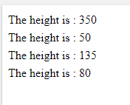
<?php declare(strict_types=1); // strict requirement ?>
<!DOCTYPE html>
<html>
<body>
<?php
function setHeight(int $minheight = 50)
{
echo "The height is : $minheight <br>";
}
setHeight(350);
setHeight();
setHeight(135);
setHeight(80);
?>
</body>
</html>

Slide 80
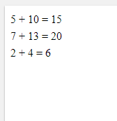
PHP Functions - Returning values
To let a function return a value, use the return statement:
<?php declare(strict_types=1); // strict requirement ?>
<!DOCTYPE html>
<html>
<body>
<?php
function sum(int $x, int $y) {
$z = $x + $y;
return $z;
}
echo "5 + 10 = " . sum(5,10) . "<br>";
echo "7 + 13 = " . sum(7,13) . "<br>";
echo "2 + 4 = " . sum(2,4);
?>
</body>
</html>

Slide 81
PHP Return Type Declarations
PHP 7 also supports Type Declarations for the return statement. Like with the type declaration for function arguments, by enabling the strict requirement, it will throw a "Fatal Error" on a type mismatch.
To declare a type for the function return, add a colon ( : ) and the type right before the opening curly ( { )bracket when declaring the function.
In the following example we specify the return type for the function:
Example
<?php declare(strict_types=1); // strict requirement
function addNumbers(float $a, float $b) : float
{
return $a + $b;
}
echo addNumbers(1.2, 5.2);
?>

Slide 82
You can specify a different return type, than the argument types, but make sure the return is the correct type:
Example
<?php declare(strict_types=1); // strict requirement
function addNumbers(float $a, float $b) : int
{
return (int)($a + $b);
}
echo addNumbers(1.2, 5.2);
?>

Slide 83
Passing Arguments by Reference
In PHP, arguments are usually passed by value, which means that a copy of the value is used in the function and the variable that was passed into the function cannot be changed.
When a function argument is passed by reference, changes to the argument also change the variable that was passed in. To turn a function argument into a reference, the & operator is used:
Example
Use a pass-by-reference argument to update a variable:
<!DOCTYPE html>
<html>
<body>
<?php
function add_five(&$value) {
$value += 5;
}
$num = 2;
add_five($num);
echo $num;
?>
</body>
</html>

Slide 84
PHP Global Variables - Superglobals
Some predefined variables in PHP are "superglobals", which means that they are always accessible, regardless of scope - and you can access them from any function, class or file without having to do anything special.
The PHP superglobal variables are:
$GLOBALS
$_SERVER
$_REQUEST
$_POST
$_GET
$_FILES
$_ENV
$_COOKIE
$_SESSION

Slide 85
PHP Form Handling
The PHP superglobals $_GET and $_POST are used to collect form-data.
PHP - A Simple HTML Form
The example below displays a simple HTML form with two input fields and a submit button:
Example
<html> <body> <form action="welcome.php" method="post"> Name: <input type="text" name="name"><br> E-mail: <input type="text" name="email"><br> <input type="submit"> </form> </body> </html>

Slide 86
When the user fills out the form above and clicks the submit button, the form data is sent for processing to a PHP file named "welcome.php". The form data is sent with the HTTP POST method.
To display the submitted data you could simply echo all the variables. The "welcome.php" looks like this:
<html> <body> Welcome <?php echo $_POST["name"]; ?><br> Your email address is: <?php echo $_POST["email"]; ?> </body> </html>
The output could be something like this:
Welcome John Your email address is john.doe@example.com

Slide 87
<html>
<body>
<form action="welcome_get.php" method="get">
Name: <input type="text" name="name"><br>
E-mail: <input type="text" name="email"><br>
<input type="submit">
</form>
</body>
</html>
and "welcome_get.php" looks like this:
<html> <body> Welcome <?php echo $_GET["name"]; ?><br> Your email address is: <?php echo $_GET["email"]; ?> </body> </html>
The code above is quite simple. However, the most important thing is missing. You need to validate form data to protect your script from malicious code.

Slide 88
The PHP Date() Function
The PHP date() function formats a timestamp to a more readable date and time.
Syntax
date(format,timestamp)
ParameterDescriptionformatRequired. Specifies the format of the timestamptimestampOptional. Specifies a timestamp. Default is the current date and time
A timestamp is a sequence of characters, denoting the date and/or time at which a certain event occurred.
Get a Date
The required format parameter of the date() function specifies how to format the date (or time).
Here are some characters that are commonly used for dates:
d - Represents the day of the month (01 to 31)
m - Represents a month (01 to 12)
Y - Represents a year (in four digits)
l (lowercase 'L') - Represents the day of the week
Other characters, like"/", ".", or "-" can also be inserted between the characters to add additional formatting.

Slide 89
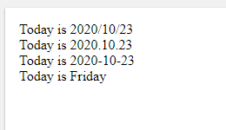
<!DOCTYPE html>
<html>
<body>
<?php
echo "Today is " . date("Y/m/d") . "<br>";
echo "Today is " . date("Y.m.d") . "<br>";
echo "Today is " . date("Y-m-d") . "<br>";
echo "Today is " . date("l");
?>
</body>
</html>

Slide 90
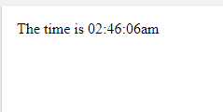
Get a Time
Here are some characters that are commonly used for times:
H - 24-hour format of an hour (00 to 23)
h - 12-hour format of an hour with leading zeros (01 to 12)
i - Minutes with leading zeros (00 to 59)
s - Seconds with leading zeros (00 to 59)
a - Lowercase Ante meridiem and Post meridiem (am or pm)
The example below outputs the current time in the specified format:
<!DOCTYPE html>
<html>
<body>
<?php
echo "The time is " . date("h:i:sa");
?>
</body>
</html>

Slide 91
Get Your Time Zone
If the time you got back from the code is not correct, it's probably because your server is in another country or set up for a different timezone.
So, if you need the time to be correct according to a specific location, you can set the timezone you want to use.
The example below sets the timezone to "America/New_York", then outputs the current time in the specified format:
Example
<!DOCTYPE html>
<html>
<body>
<?php
date_default_timezone_set("America/New_York");
echo "The time is " . date("h:i:sa");
?>
</body>
</html>

Slide 92

<!DOCTYPE html>
<html>
<body>
<?php
$d=strtotime("tomorrow");
echo date("Y-m-d h:i:sa", $d) . "<br>";
$d=strtotime("next Saturday");
echo date("Y-m-d h:i:sa", $d) . "<br>";
$d=strtotime("+3 Months");
echo date("Y-m-d h:i:sa", $d) . "<br>";
?>
</body>
</html>

Slide 93

<!DOCTYPE html>
<html>
<body>
<?php
$d=strtotime("tomorrow");
echo date("Y-m-d h:i:sa", $d) . "<br>";
$d=strtotime("next Saturday");
echo date("Y-m-d h:i:sa", $d) . "<br>";
$d=strtotime("+3 Months");
echo date("Y-m-d h:i:sa", $d) . "<br>";
?>
</body>
</html>

Slide 94

<!DOCTYPE html>
<html>
<body>
<?php
$startdate=strtotime("Saturday");
$enddate=strtotime("+6 weeks", $startdate);
while ($startdate < $enddate) {
echo date("M d", $startdate) . "<br>";
$startdate = strtotime("+1 week", $startdate);
}
?>
</body>
</html>

Slide 95

PHP File Handling
File handling is an important part of any web application. You often need to open and process a file for different tasks.
PHP readfile() Function
The readfile() function reads a file and writes it to the output buffer.
Assume we have a text file called "webdictionary.txt", stored on the server, that looks like this:
<!DOCTYPE html> <html> <body> <?php echo readfile("webdictionary.txt"); ?> </body> </html>

Slide 96
PHP Open File - fopen()
A better method to open files is with the fopen() function. This function gives you more options than the readfile() function.
The first parameter of fopen() contains the name of the file to be opened and the second parameter specifies in which mode the file should be opened. The following example also generates a message if the fopen() function is unable to open the specified file:
<!DOCTYPE html> <html> <body> <?php $myfile = fopen("webdictionary.txt", "r") or die("Unable to open file!"); echo fread($myfile,filesize("webdictionary.txt")); fclose($myfile); ?> </body> </html>

Slide 97


Slide 98
PHP Read File - fread()
The fread() function reads from an open file.
The first parameter of fread() contains the name of the file to read from and the second parameter specifies the maximum number of bytes to read.
The following PHP code reads the "webdictionary.txt" file to the end:
fread($myfile,filesize("webdictionary.txt"));
PHP Close File - fclose()
The fclose() function is used to close an open file.
The fclose() requires the name of the file (or a variable that holds the filename) we want to close:
<?php $myfile = fopen("webdictionary.txt", "r"); // some code to be executed.... fclose($myfile); ?>

Slide 99

PHP Read Single Line - fgets()
The fgets() function is used to read a single line from a file.
The example below outputs the first line of the "webdictionary.txt" file:
<!DOCTYPE html> <html> <body> <?php $myfile = fopen("webdictionary.txt", "r") or die("Unable to open file!"); echo fgets($myfile); fclose($myfile); ?> </body> </html>

Slide 100

PHP Check End-Of-File - feof()
The feof() function checks if the "end-of-file" (EOF) has been reached.
The feof() function is useful for looping through data of unknown length.
The example below reads the "webdictionary.txt" file line by line, until end-of-file is reached:
<!DOCTYPE html> <html> <body> <?php $myfile = fopen("webdictionary.txt", "r") or die("Unable to open file!"); // Output one line until end-of-file while(!feof($myfile)) { echo fgets($myfile) . "<br>"; } fclose($myfile); ?> </body> </html>

Slide 101
PHP Read Single Character - fgetc()
The fgetc() function is used to read a single character from a file.
The example below reads the "webdictionary.txt" file character by character, until end-of-file is reached:
After a call to the fgetc() function, the file pointer moves to the next character.
<!DOCTYPE html> <html> <body> <?php $myfile = fopen("webdictionary.txt", "r") or die("Unable to open file!"); // Output one character until end-of-file while(!feof($myfile)) { echo fgetc($myfile); } fclose($myfile); ?> </body> </html>

Slide 102
PHP File Upload
Create The HTML Form
Next, create an HTML form that allow users to choose the image file they want to upload:
<!DOCTYPE html> <html> <body> <form action="upload.php" method="post" enctype="multipart/form-data"> Select image to upload: <input type="file" name="fileToUpload" id="fileToUpload"> <input type="submit" value="Upload Image" name="submit"> </form> </body> </html>
Some rules to follow for the HTML form above:
Make sure that the form uses method="post"
The form also needs the following attribute: enctype="multipart/form-data". It specifies which content-type to use when submitting the form

Slide 103
Without the requirements above, the file upload will not work.
Other things to notice:
The type="file" attribute of the <input> tag shows the input field as a file-select control, with a "Browse" button next to the input control
<?php $target_dir = "uploads/"; $target_file = $target_dir . basename($_FILES["fileToUpload"]["name"]); $uploadOk = 1; $imageFileType = strtolower(pathinfo($target_file,PATHINFO_EXTENSION)); // Check if image file is a actual image or fake image if(isset($_POST["submit"])) { $check = getimagesize($_FILES["fileToUpload"]["tmp_name"]); if($check !== false) { echo "File is an image - " . $check["mime"] . "."; $uploadOk = 1; } else { echo "File is not an image."; $uploadOk = 0; } } ?>

Slide 104
PHP script explained:
$target_dir = "uploads/" - specifies the directory where the file is going to be placed
$target_file specifies the path of the file to be uploaded
$uploadOk=1 is not used yet (will be used later)
$imageFileType holds the file extension of the file (in lower case)
Next, check if the image file is an actual image or a fake image

Slide 105
PHP Connect to MySQL
PHP 5 and later can work with a MySQL database using:
MySQLi extension (the "i" stands for improved)
PDO (PHP Data Objects)
Earlier versions of PHP used the MySQL extension. However, this extension was deprecated in 2012.
<?php $servername = "localhost"; $username = "username"; $password = "password"; // Create connection $conn = new mysqli($servername, $username, $password); // Check connection if ($conn->connect_error) { die("Connection failed: " . $conn->connect_error); } echo "Connected successfully"; ?>

